Slide 1
NON ULCERATIVE SUPERFICIAL KERATITIS
Dr. VIVEKANAND U

Slide 2
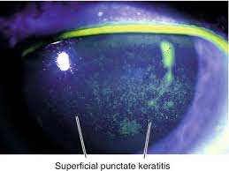

Slide 3
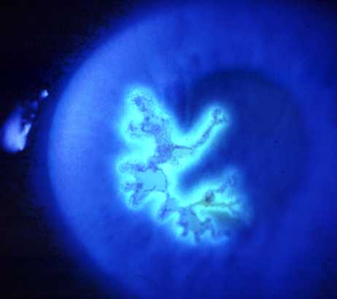
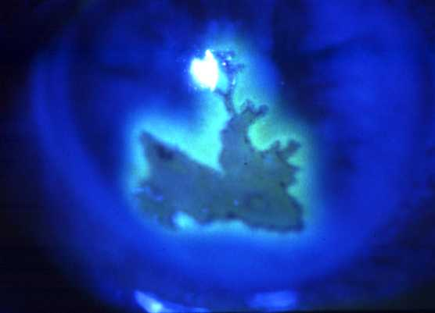
Herpes simplex epithelial keratitis
Dendritic ulcer with terminal bulbs
May enlarge to become geographic
Stains with fluorescein
Treatment
Aciclovir 3% ointment x 5 daily x 14 – 21 days
Trifluorothymidine 1% drops Two hourly until ulcer heals and then qid x 5 d d
Debridement if non-compliant

Slide 4
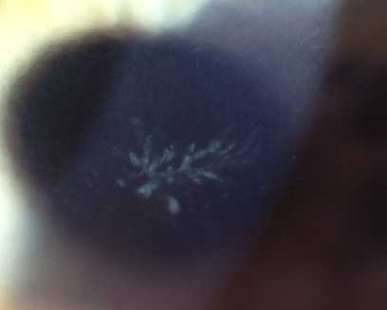
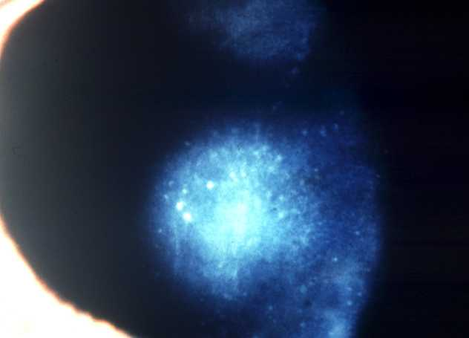
Herpes zoster keratitis
Acute epithelial keratitis
Nummular keratitis
Develops in about 50% within
2 days of rash
Develops in about 30% within
10 days of rash
Small, fine, dendritic or stellate
epithelial lesions
Multiple, fine, granular deposits
just beneath Bowman membrane
Tapered ends without bulbs
Halo of stromal haze
Resolves within a few days
May become chronic
Treatment - topical steroids, if appropriate

Slide 5
NON ULCERATIVE SUPERFICIAL KERATITIS
DIFFUSE SUPERFICIAL KERATITIS
Acute diffuse superficial keratitis
Staphylococcal or gonococcal –
Faint diffuse epithelial oedema, grey, epithelial erosions
Tobramycin, gentamicin
Chronic diffuse superficial keratitis
Rosacea, phlyctenulosis and is typically associated with pannus formation.
SUPERFICIAL PUNCTATE KERATITIS
Multiple, spotty lesions in the superficial layers of cornea.
Causes
Viral, chalmydial, trophic, dry eye, toxic, allergic, idiopathic
Topical steroids, artificial tears, specific treatment

Slide 6
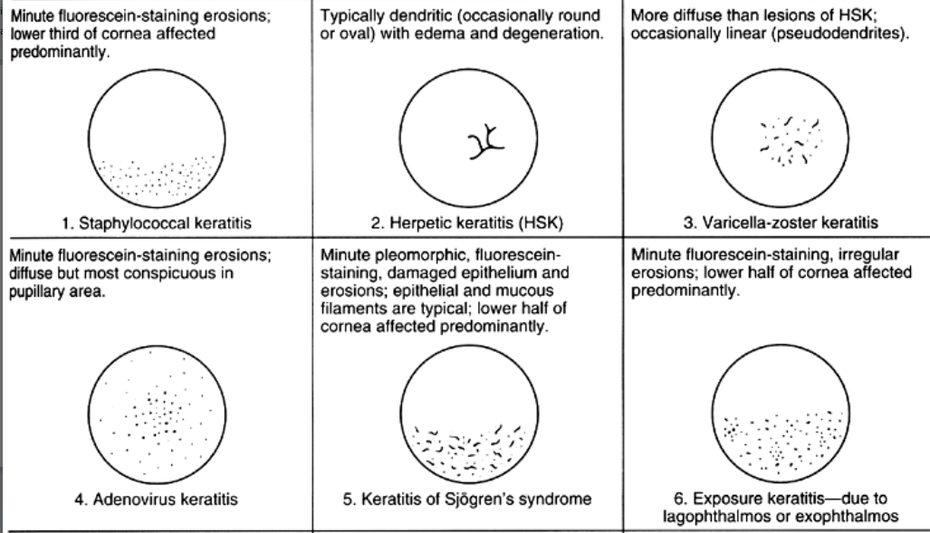

Slide 7
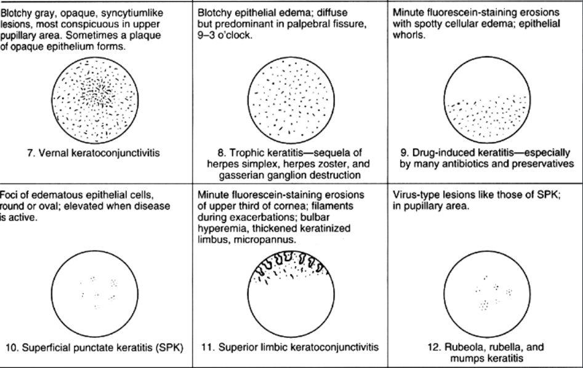

Slide 9
SUPERFICIAL PUNCTATE KERATITIS - other types
PHOTO-OPHTHALMIA
Occurrence of multiple epithelial erosions due to the effect of ultraviolet rays especially from 311 to 290 m
Short circuit, naked arc light, snow blindness
Latent period: 4-5 hrs
Treatment: Crooker’s glass

Slide 10
SUPERFICIAL PUNCTATE KERATITIS - other types
SUPERIOR LIMBIC KERATOCONJUNCTIVITIS
Superior limbus
Congestion, filaments, punctate keratitis
Treatment
Artificial tears , Topical corticosteroids , faint diathermy,• Recession or resection of a 3–4 mm wide perilimbalstrip of conjunctiva
Therapeutic soft contact lenses

Slide 11
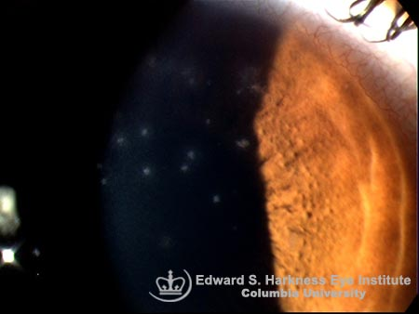
SUPERFICIAL PUNCTATE KERATITIS - other types
THYGESON’S SUPERFICIAL PUNCTATE KERATITIS
Chronic, recurrent bilateral superficial punctate keratitis
Conjunctiva is uninflamed (no conjunctivitis)
Central part (pupillary area) of cornea
Treatment
Self limiting, topical steroids, Therapeutic soft contact lens

Slide 12
SUPERFICIAL PUNCTATE KERATITIS - other types
FILAMENTARY KERATITIS
Superficial punctate keratitis, associated with formation of corneal epithelial filaments
Causes:
Keratoconjunctivitis sicca (KCS),
Superior limbic keratoconjunctivitis,
Epitheliopathy due to radiation keratitis,Following epithelial erosions as in herpes simplex keratitis, Thygeson’s superficial punctate keratitis, recurrent corneal erosion syndrome and trachoma
Idiopathic
Mechanical removal, soft contact lens, treating cause

